Slide 1
The Place of Shared Decision Making (SDM) in Social Work Practice
Prof. Shulamit Ramon s.ramon@herts.ac.uk
14th June 2022
Notes:
1

Slide 2
What is Shared Decision Making
Elwyn et al 2014.
SDM is a process of sharing information, experience, and preferences, in which the decision is not known in advance.
According to Charles et al Gafni (1999) it entails:
the inclusion of at least two people, person and service provider, and at times families
who share information
take steps to build a consensus about preferred treatment
reach agreement on the treatment to implement
Deegan, Drake and Rapp (2010) add that the two participants are experts, though in different aspects. Service users are expert in experience about themselves who bring to the process experiential knowledge, whereas providers are experts in scientific knowledge.
Necessary preconditions for SDM to take place: Respect, Value, Trust and Honesty

Slide 3
Why engage social work clients in SDM
A Human Right: The right to have a say about one’s life: Nothing about me Without Me
The centrality of experiential knowledge in SDM vs. the assumption that the professional knows best
What is experiential knowledge? What I have learned about the impact of specific problems on me, what have I learned about the effectiveness of intervention options from my life experience, the personal strategies I have developed to cope with difficulties
What are my priorities when I am experiencing difficulties
Importance of motivation to be active in decisions about my life
The usefulness of being able to share my doubts with service providers
Recognition of the individualised nature of response to different interventions (including medication, moving house, having a new carer, family relationships, networking, employment)

Slide 4
Why share knowledge and options
The value of honesty in the relationships between the person and service provider
Saving time
Learning from each other’s knowledge; checking options
The centrality of being given responsibility and of being able to take responsibility for my life
Preventing failure or repeat of negative responses
SDM as a key component within a Person Centred Approach

Slide 5
Areas of social work in which SDM could be useful
People with disabilities : decisions about living arrangements, social networking, use of personal budget, employment opportunities, interpersonal relationships
Child protection issues: the best solution re where the child should live/with whom, behavioural change of parents, children, other care givers
Older people – loneliness, physical ill health, mental ill health, retaining abilities
Supporting the process of weighing intervention options alongside other professionals, and in instances where another professional is more knowledgeable (e.g. medication)
The centrality of good information giving
The centrality of engaging people in decisions about their lives: recognition of interdependency

Slide 6
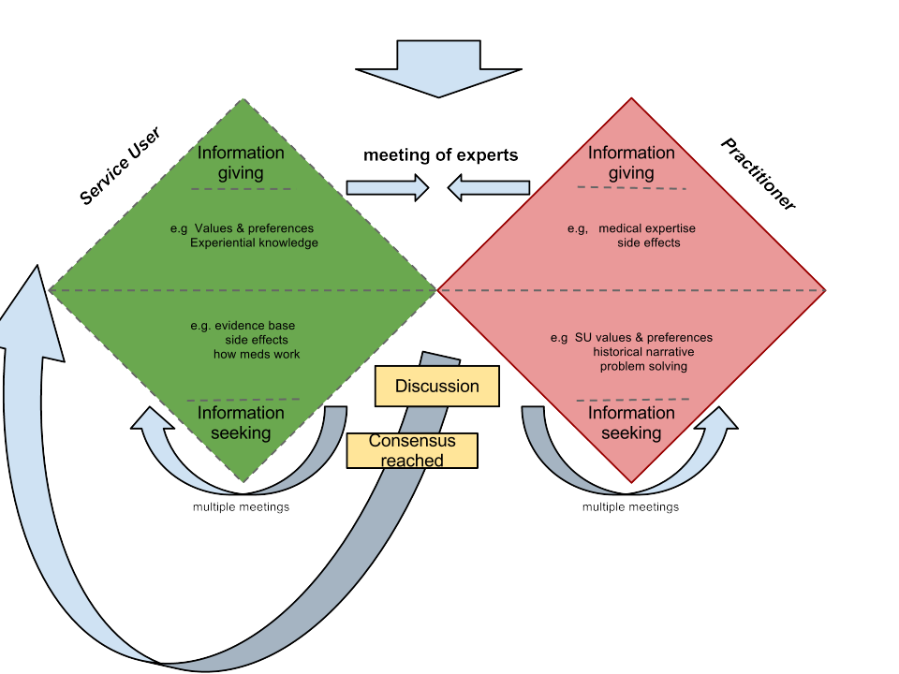
The ideal relationships between the two experts

Slide 7
Background to SDM
The focus on SDM has began in terminal care, accompanied with the development of the Decisional Conflict scale aid (O’Connor et al, 2006, Gravelink et al 2019)
This has been in existence for some time, especially around difficult decisions such as to continue or discontinue medical interventions, to opt for more radical treatment which comes with more risky side effects or not, i.e. where there is a conflictual decision to be made.
SDM enables weighing the pluses and minuses of each option.
Social workers are often partners to the process of SDM in terminal care, either because they have worked before with the person and/or their nearest relatives, such as supporting people in entering a hospice, or because they can help in co-ordinating interventions and networks (e.g. enabling a meeting with a family member who has been distanced).

Slide 8
Clients legal right to full information in the UK: Mrs M case
Mrs Montgomery was a woman of small stature and a diabetic under the care of a doctor during her pregnancy and labour. The doctor did not inform her of the 9-10% risk of shoulder dystocia, where the baby's shoulders are unable to pass through the pelvis among diabetic women as she (the doctor) viewed the problem as being very slight and a caesarean section was not in Mrs M’s interest.
The baby suffered from severe disabilities after birth due to shoulder dystocia. Mrs M sued the health board for negligence on the part of the doctor for failing to advise her on the risk of shoulder dystocia.
The case went all the way to the Supreme Court, which found in favour of Mrs M, and confirmed that a patient has to give informed consent, and the only way they can do that is if they are aware of all the available options and the risks associated with each one
The implications of this ruling are relevant to any branch of health and social care in the UK, which has a legal system based on precedence.

Slide 9
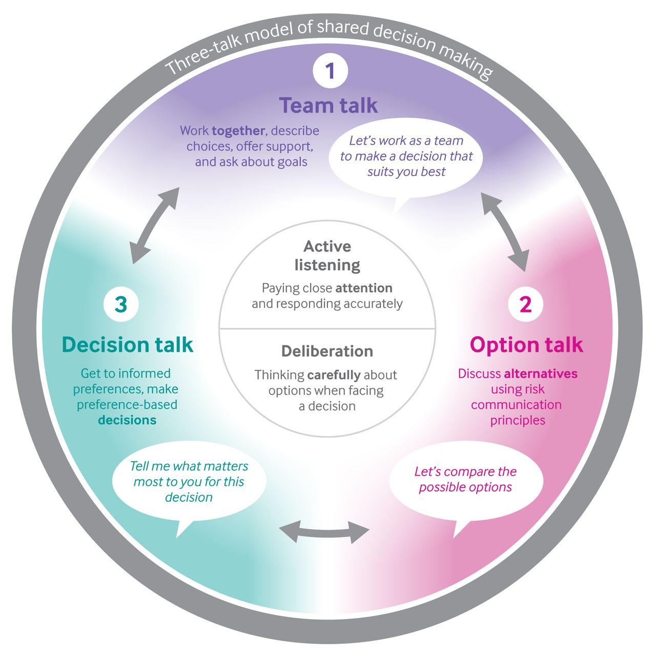
The Three Talks Model

Slide 10
The Three Talks Model: advantages and disadvantages
This is the most frequently used approach, where the focus is on the process of SDM.
It has the advantage of being simple
The Three Questions tool
Used in physical ill health but also in mental health
Has considerable research evidence internationally
Recognition that SDM requires shift in power and control over the
interactive process between the person and the clinician (Elwyn et al, 2017)

Slide 13
Application of the Three Talk Model
Scenario: Sarah and Michael have experienced addiction problems, as a result their baby daughter is currently looked after by Sarah’s sister (Joanna) and her husband (Peter).
Sarah and Michael would like to have their daughter living with them, or at least to have her some of the time
You are their social worker. You can understand their wish, but you also cannot allow the baby to be looked after by drug addicted parents, as you have a clear legal mandate to protect children.
How do you think the Three Talk Model of SDM would improve the current tense relationships between Sarah, Michael, Joanna and Peter?
Team talk: providers and service users
Options: baby stays with current carers until the parents stop their addiction; parents visit baby regularly; baby comes to visit parents with her current carers; planning end of addiction stages
Deliberations stage; Decision talk

Slide 14
The potential place of a social worker in the scenario
As co-ordinator of the meeting
In encouraging the dialogue between the two couples
Invite a social worker to report on the development of the baby
Enable the two couples to set an action plan
Meeting separately each couple

Slide 15
Family Group conferences
What is Family Group Conference (Ramon, 2021)
Established by social workers, mainly in child protection issues, but also in restorative justice and mental health.
The process
An example of a young girl organising her FGC (with help)
https://www.youtube.com/watch?v=P8Zc8QiJV7Y

Slide 16
The study by Nurmatov et al (2020) Impact of shared decision-making family meetings on children’s out-of-home care, family empowerment and satisfaction: A systematic review
continues to be the most comprehensive one in the context of child protection.
This summary focuses on meetings aimed at improving shared-decision making with families. In the UK, these meetings are often referred to as Family Group Conferences (FGCs).
The evidence regarding the effectiveness of shared decision-making is inconclusive. All five of the primary outcomes assessed were rated as having a low to very low strength of evidence
However, the results could be interpreted in a positive direction of effectiveness of shared decision-making for prevention of out-of-home care
This summary of 32 sources included only two studies from the UK
Family participation is a fundamental principle in children’s social care and more work is needed to improve the quality consistency of the services that are designed to achieve this
Further research is needed to provide a stronger evidence base for shared decision-making services

Slide 17
Compare with current UK child protection conferences
A recent 2021 study of child protection conferences (Richardson Foster et al) in which social workers participate alongside other relevant disciplines, parents and at times children participate, highlights:
Low level of child participation
Child-focused decision making and planning were rarely achieved
Other studies highlight that parents feel accused and unable to express themselves in these meetings
In the majority of cases, families become involved with children’s social care because they are parenting in conditions of adversity, rather than because they have caused or are likely to cause significant harm to their children. We have a shared obligation to help families raise their children. Communities can also play a key role in supporting families, in some cases removing the need for statutory intervention (McAlister, 2021).

Slide 18
Springbank: An example of a closed ward regime: Positive Risk Taking
https://www.youtube.com/watch?v=bcO0qrTYf2s
BBC
https://www.youtube.com/watch?v=PT9LrrPCy_I
Jasmin
The background to the decision to apply the SDM approach to this closed ward for women with Borderline Personality Disorder
How it works
Key results (Crawford, 2021, risk assessment perspectives)

Slide 19
Springbank Findings

Slide 20
Springbank results
Contacts with CPFT
•Average days before admission with CPFT
•1088 days
•Average follow-up period post-discharge
•403 days
•Outcome:
•~60 –90% reduction in contacts after treatment.

Slide 21
What can SDM offer the client
Help you to learn how to ask for information, find information and evaluate information
Motivate you to become proactive about your own care
Help you to take responsibility for your recovery
Benefits:
You will be a more effective communicator
You will be more knowledgeable about your condition and the various different ways it can be treated
You will have a more genuine relationship with your provider based on mutual respect and trust.
This will help save a lot of time in finding an effective treatment plan as everything will be discussed and agreed in advance

Slide 22
What can SDM offer to providers
More holistic knowledge
Enhanced collaboration between the providers and the clients
Greater likelihood that the client will be motivated to follow any agreed decision
Greater degree of honesty in the relationships; hence less waste of time
An opportunity to value the solutions proposed by the providers vs
Those proposed by the client
Mutual respect and trust
An opportunity to put in practice health and social care values, such as self determination

Slide 23
What would be the pros and cons of applying SDM systematically in SW?
It fits well social work values, such as self determination and the right to fail

Slide 24
In summary
I have attempted to provide you with a taster on SDM, one that includes its key components and issues.
It is clear that most of the evidence about its effectiveness is positive, even if it does not always lead to shorter institutionalised solutions.
It applies to any area of social work, and to any activity of social workers.
Thus far social work service users are ready to follow the SDM process, while professional providers are less ready to implement it.
We hope you will use the presentation and the references to have more in-depth knowledge of SDM.

Slide 25
BBC Look East, video on Springbank, 23rd July 2018 https://www.youtube.com/watch?v=bcO0qrTYf2s
Charles, C., Gafni, A., Whelan, T. (1999) Decision Making in the physician-consumer encounter: revising the shared treatment decision making model. Social Sciences and Medicine, 49 (5), 651-61.
Crawford, O.A. (2021) Rethinking Risk Issues in Borderline Personality Disorder Units: Patient and Staff Perspective. Careus 13(2); e 13557 doi: 10.7759/careus.13557.
Deegan, P.M. et al (2010) A web approach to support recovery and shared decision making in psychiatric medication clinics. Psychiatric Rehabilitation Journal, 23(1): 23-8.
De Jong, G. et al (2018) The Process of Family Group Conferences in Public Mental Health Care: A multiple case study. British J of Social work 48:352-70. Doi: 10.1093/bjsw/bcx037.
Elwyn, G. et al (2017) A three-talk model for Shared Decision Making: Multistage Consultation Process. BMJ, 359. doi.org/10.1136/bmj.j4891
Gravelnik, M. et al (2019) Decisional Conflict Scale Use Over 20 years: The Anniversary Review. Medical Decision Making, 39(4), 301-314. Doi: 10.1177/0272989X19851345.
Grim, K., Rosenberg, D., Svedberg, P., & Schön, U-K. (2016) Shared decision making in mental health care: A user perspective on decisional needs in community-based services. InternationalJournal of Qualitative Studies on Health and Well-being, 11(1), 1-8.
Hamman, J. et al (2006) Shared Decision Making for in-patients with Schizophrenia. Acta Psychiatrica Scandinavica, 114(4): 265-73.
Hamman, J. et al (2011) How to Speak to Your Psychiatrist: shared decision making training for in-patients with Schizophrenia. Psychiatric Services, 62, 10, 1281-21.
Hamman, J. et al (2019) Implementing SDM on acute psychiatric wards: A cluster-randomized trial with inpatients, suffering from Schizophrenia (SDM-PLUS). Epidemiology and Psychiatric Sciences, 29, e137 1-7. https://doi.org/10.1017/s20457960000505

Slide 26
Katz, S. et al (2018) Retrospective Accounts of the Process of Using and Discontinuing Psychiatric Medication. Qualitative Health research 1-13. Doi: 10.1177/1049732318793418.
Liverpool, et al (2021) an Affective-Appraisal Approach for Parental Shared Decision Making in Children and Young People’s Mental Health Settings. Frontl.Psychiatry 12:626848. doi: 10.3389/fpsyt.2021.626848
Lysaker, P.H. (2018) Insight in Schizophrenia Spectrum Disorders: relationships with Behaviour, Mood and Perceives quality of Life, underlying causes and emerging treatments. World Psychiatry 17(1): 12-23. Doi: 10.1002/wps.20508
MacDonald-Wilson, K.L. et al (2016) A successful implementation strategy to support adoption of decision making in mental health services. Community Mental Health Journal 37(5). Doi:10.1007/s10597-016-0027-1.
Malmberg-Heimonen, I. Johansen, S. (2014) Understanding the longer-term effects of Family Group Conferences. European J of Social Work, 17:556-71.

Slide 27
Manthorpe, J., Rapaport, J. (2020) researching Family Group Conferences in Adult services Methods Review. London: NIHR School of Social care Research.
May, JM. et al (2016) Dialectical Behavioural Therapy as Treatment for Borderline Personality Disorder. Ment Health Clin (Internet) 6(2):62-7. Doi: 10.9740/mhc.2016.03.62
Putnam, N., Martindale, B (ed) (2022) Open Dialogue for Psychosis: Organising Mental Health Services to Prioritise Dialogue, Relationships and Meaning. London: Routledge
Quirk, A.D. (2015) Obstacles to Shared decision Making in Psychiatric Practice: Findings from three Qualitative Observation Studies. Saarbrucken: Lambert Academic Publishers.
Ramon, S. et al (2017) Key Issues in the process of implementing shared decision making in mental health practice. Mental Health Review Journal, 22, 3, 257-274
Ramon, S. (2021) Family Group Conferences as a Shared Decision Strategy in Adults Mental Health Work. Front. Psychiatry 12:663288. Doi: 10.3389/fpsyt.2021.663288.
Richardson Foster, H. et al (2021) How Child-Focused are CPC? Child Abuse Review, 30:458-472.
Simmons, MB., et al (2018) The Choice Pilot Project: challenges of implementing combined peer work and shared decision programme in an early intervention service. Early Intervention, 12:964-71. Doi:10.1111/eip.12527.
Stone, M. et al (2019) Estranged Relations: coercion and care in narratives of supported shared-decision in mental health care. Med Humanit 2019:0:1-11, doi:10.1136/medhum-2018-011521.
Thomas, E. et al (2021) A Systematic Review of shared decision-making Interventions for service Users with Mental Illness: State of the Science and future Directions. Psychiatric Services 72:1288-1300 doi: 10.1176/appi.ps.2020000429

